Slide 1
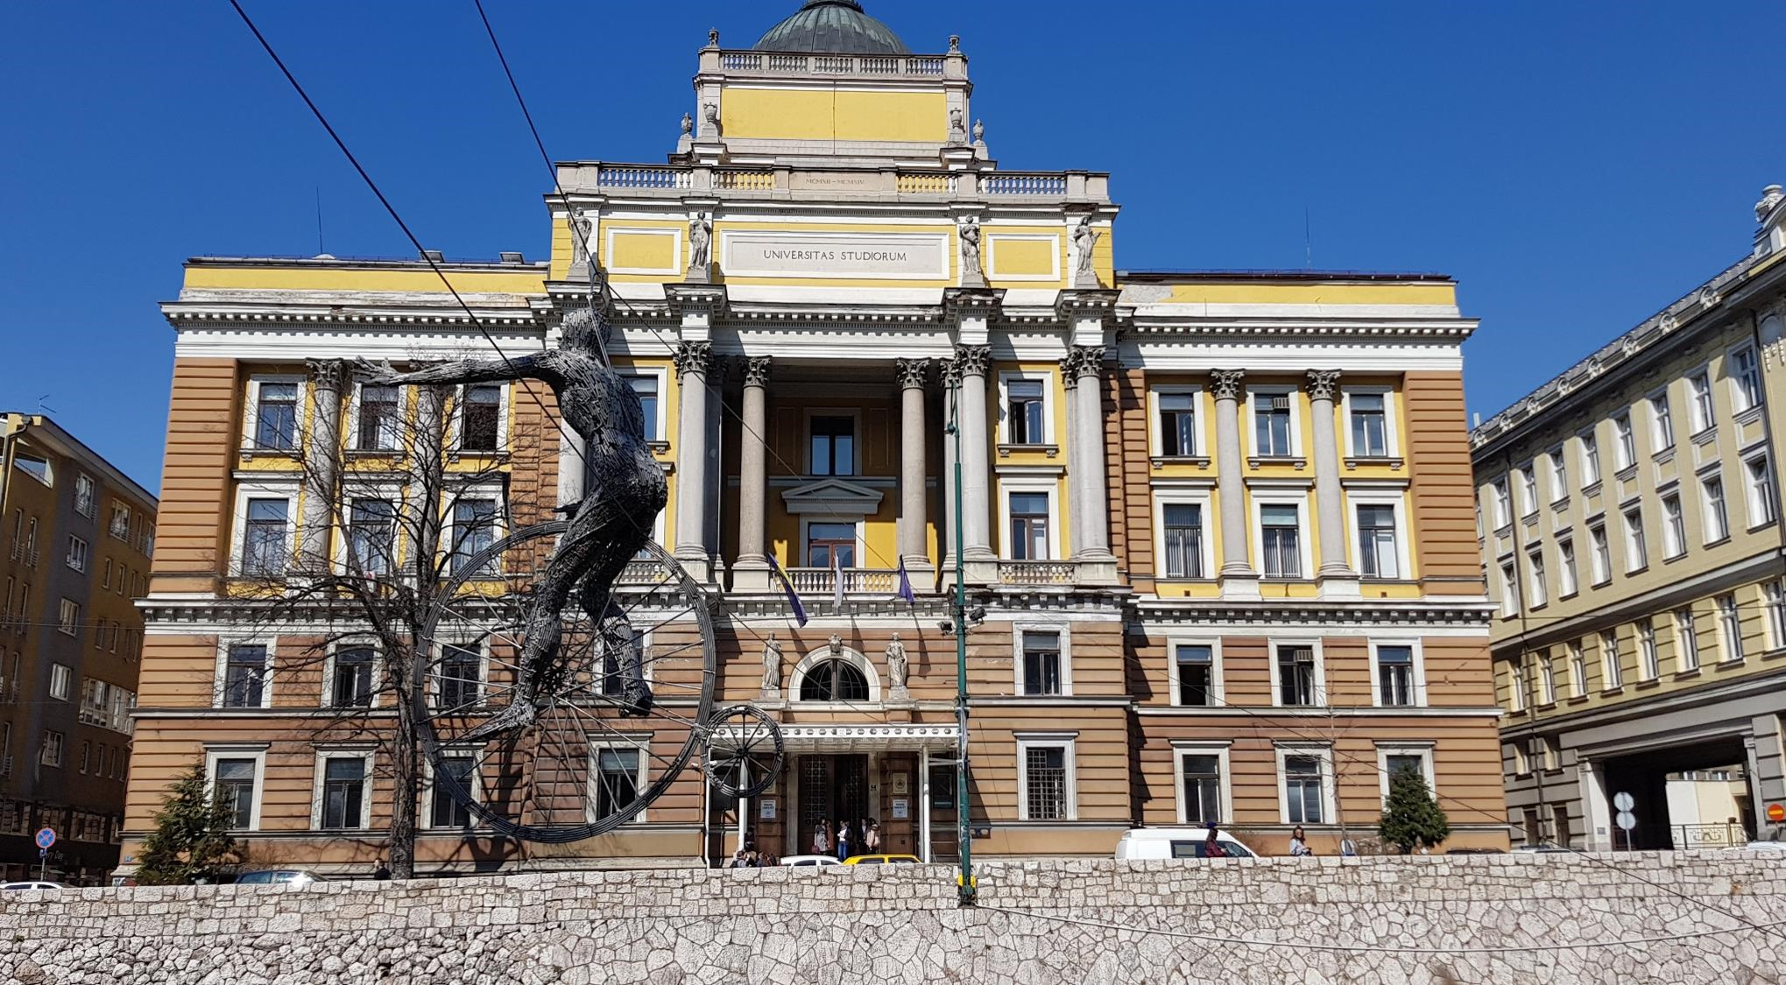
UNIVERSITY OF SARAJEVO

Slide 2
Ovaj slajd sa uputama brisati
Pred vama je prezentacija o UNSA sa informacijama o našoj instituciji koje su relevantne za inostrana prezentiranja pred međunarodnim auditorijem.
Imate potpunu kreativnu slobodu da prezentaciju skratite ili proširite u skladu sa potrebama programa u kojem učestvujete
Prezentacija koja je preuzeta na linka: https://www.unsa.ba/istrazivanje-i-saradnja/medunarodna-saradnja/izvjestaji-dokumenti-i-publikacije se ažurira godišnje (ili po potrebi) i sadrži potrebne informacije koje su obično traže prilikom prezentiranja institucije.
SRETNO!

Slide 3
Location in the world
Bosnia and Herzegovina - heart shape land
Approx. 3.5 million population
Capital city: Sarajevo
European Jerusalem
True bridge between East and West culture and civilisation

Slide 4
About UNSA
Founded in 1949
First university in Bosnia and Herzegovina
Public institution
City-university
Integrated university
Rectorate in the center of the city
23 faculties
3 academies
7 research centers and institutes
More at: http://www.unsa.ba

Slide 5
About UNSA: students and staff members
22.000 students
approx. 800 international students
Sarajevo is a student city (15% are students) and out of that 98% are from the UNSA
2.640 University staff members:
1.650 teaching staff
990 non-teaching staff

Slide 6
Did you know? (interesting facts)
1 Nobel winner for literature (Bridge over Drina 1961)
1 Academy Award (Oscar) winner (No Man‘s Land, best foreign moivie in 2002)
1 European Film Award for Best Film (Quo Vadis, Aida 2021)
Winter Olympic games (1984) support in organisation
Has developed post-war rebuilding management
All city – one campus
Inclusive university
Comprehensive university

Slide 7
Study Programmes
500+ study programs
Bologna Education System since 2005
ECTS (180 – 120 – 180) with some exceptions
Bachelor, Master, Integrated (BA+MA), PhD, Professonal studies
12 Study programmes in English
300+ modules in „English-friendly“ language
More at: http://www.registar.unsa.ba

Slide 8
Study Programmes
Arts
Humanities
Medicine
Natural and Bio-technical
Social
Technical

Slide 9
Research
HR Excellence in Research
HorizonEurope
Cost
Capacity Building projects

Slide 10
EUPeace (European alliance)
The University of Sarajevo became part of the European university initiative called EUPeace (European University for Peace, Justice, and Inclusive Societies). The EUPeace alliance/network focuses on increasing the effects of internationalization under the prefix of nurturing a peaceful, just and inclusive European society, at different levels.
More at: http://www.unsa.ba/eupeace

Slide 11
Internationalisation at UNSA
Started in 1965 by signing the first memorandum of understanding with the University of Greisfwald, Germany
1970s – Summer schools with the USA
1980 – accepting degree students from Middle East and Africa
1984 – Winter Olympic Games
1992-1995 – War and Agression in Bosnia and Herzegovina
1996 – entering EU funds (Tempus)
2007 – entering Erasmus Mundus Action 2 External Window
More at: https://www.unsa.ba/en/research-and-cooperation/international-relations

Slide 12
International Relations Office activities
Memorandums of Understanding
Bilateral and consortium cooperation
Incoming and outgoing mobility (Erasmus+, CEEPUS, Freemovers)
International Staff Training Week
Scholarship Fair
Welcome day
Open - platform
Publications and Guides for international mobilities
Exhibition+
More at: https://www.unsa.ba/en/research-and-cooperation/international-relations

Slide 13
Internationalisation at UNSA
UNSA has
147 bilateral agreements (memorandums of understanding)
150+ KA171 inter-institutional agreements within Erasmus+
membership in 13 international networks (ALUm, AUF, AARC, BUA, CUAM, DRC, EMUNI, EUA, FUNi, IUC Dubrovnik, UNICA, Uniadrion, SGrup)
More at: https://www.unsa.ba/en/research-and-cooperation/international-relations

Slide 14
Erasmus@UNSA
Officially started in 2007 through Erasmus Mundus
2014 entered Erasmus+
2021 entered 2nd phase of Erasmus+
2022 signed Erasmus Charter for Higher Education 2021-2027
BA SARAJEV01
Incoming mobilities (per year):
Students: approx. 100
Staff: approx. 150
Outgoing mobilities (per year): :
Students: approx. 200
Staff: approx. 150
More at: https://www.international.unsa.ba

